Slide 1

AI training group
Weekly Report
Nguyen khai phu – SEP 29 2023

Slide 2
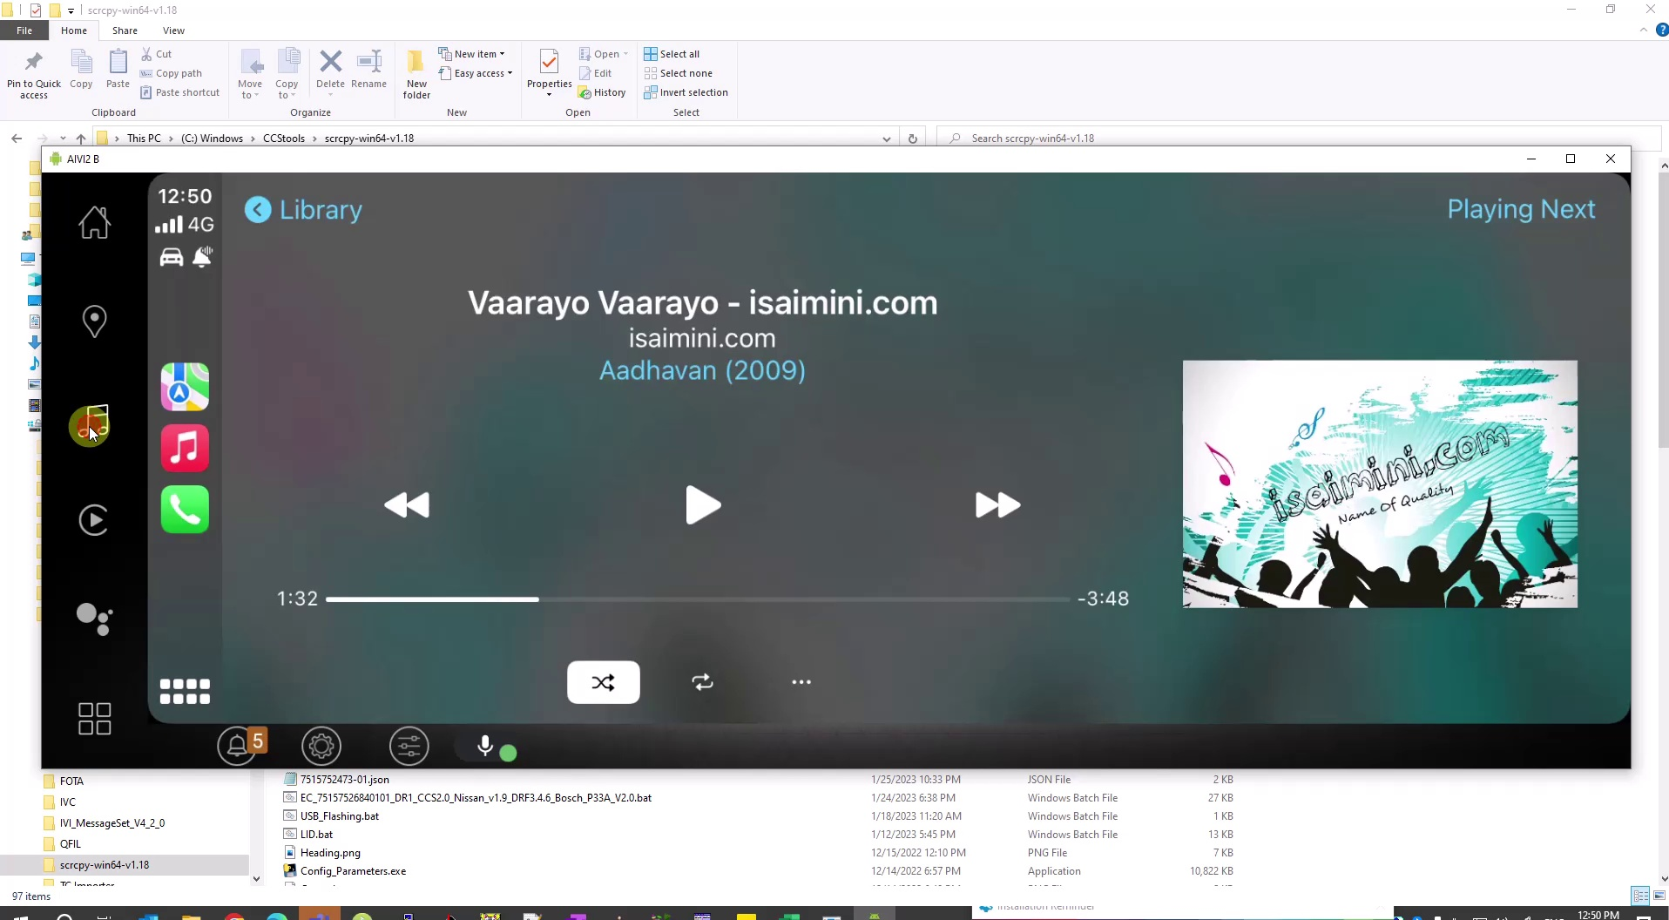
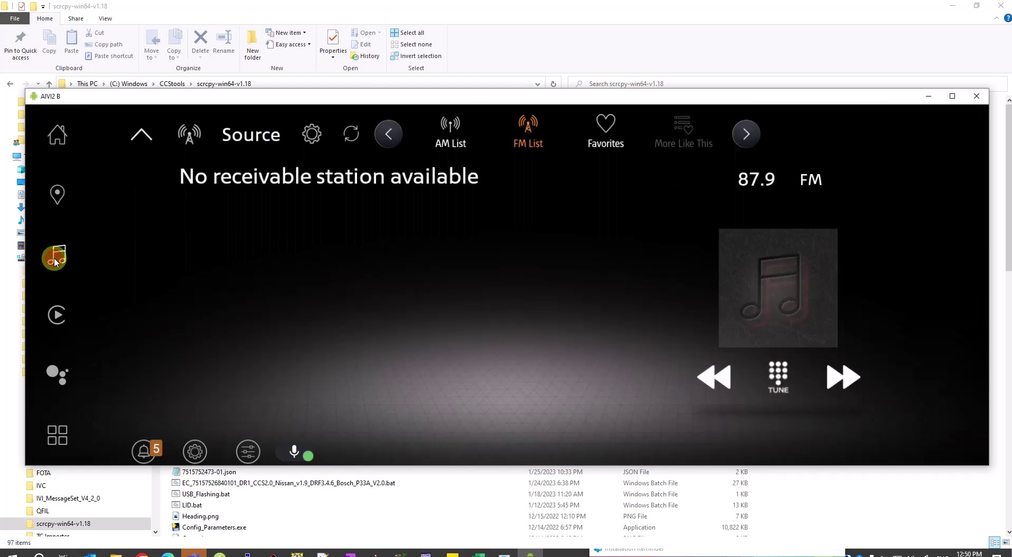

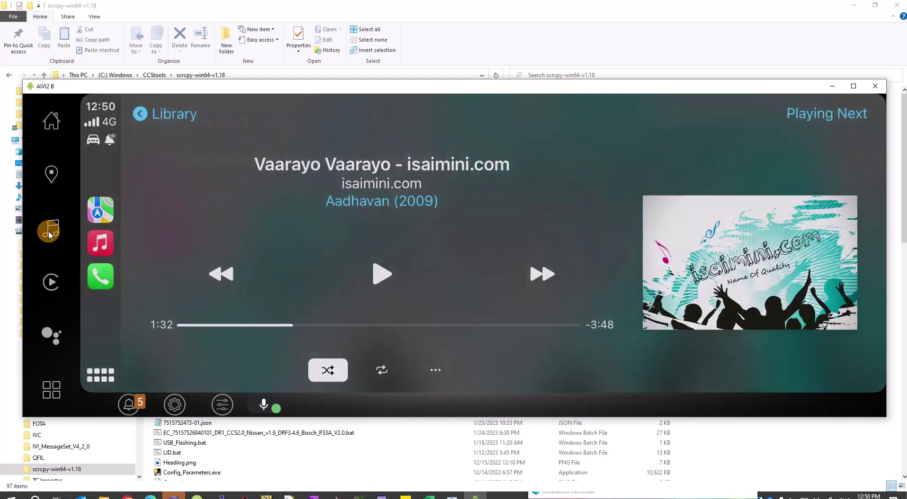
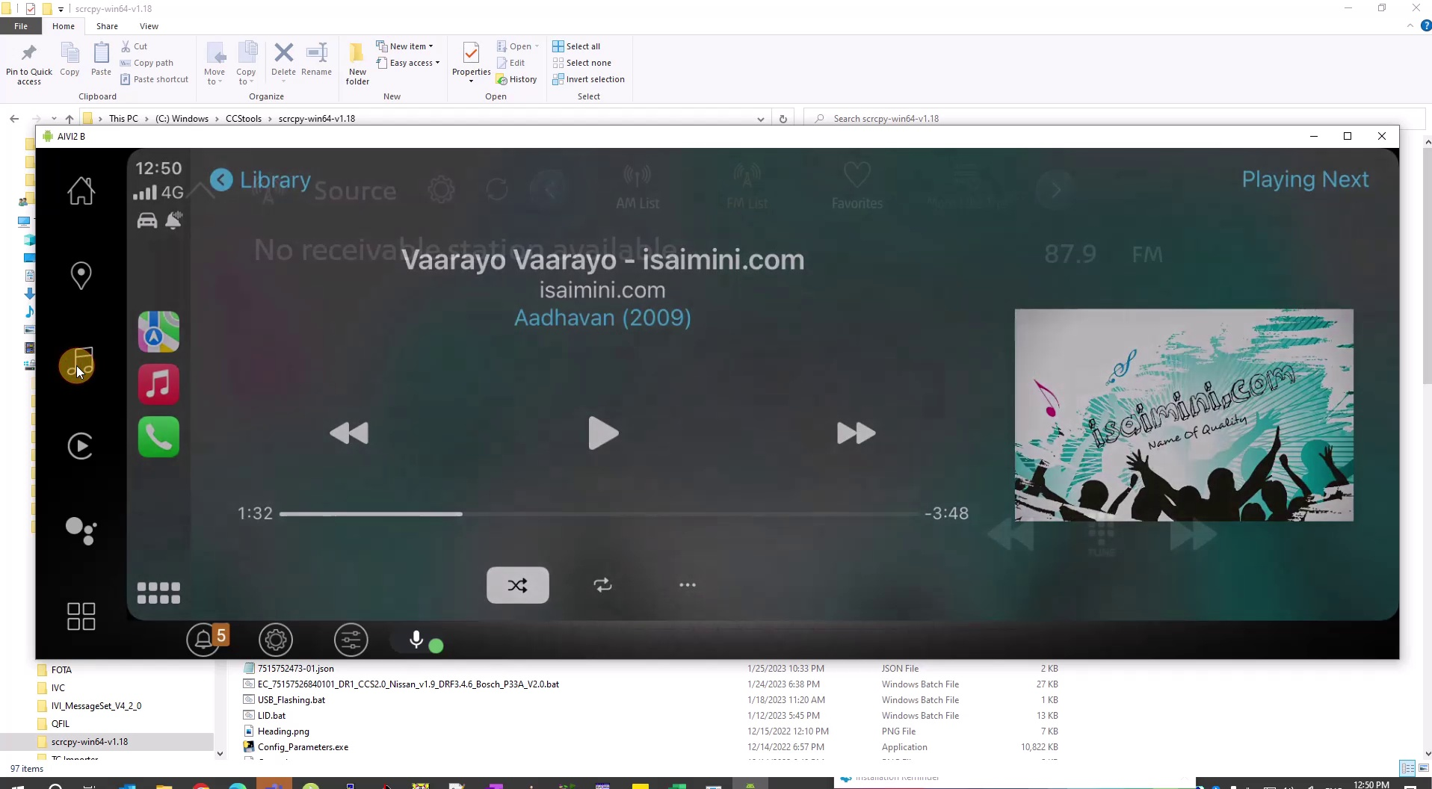
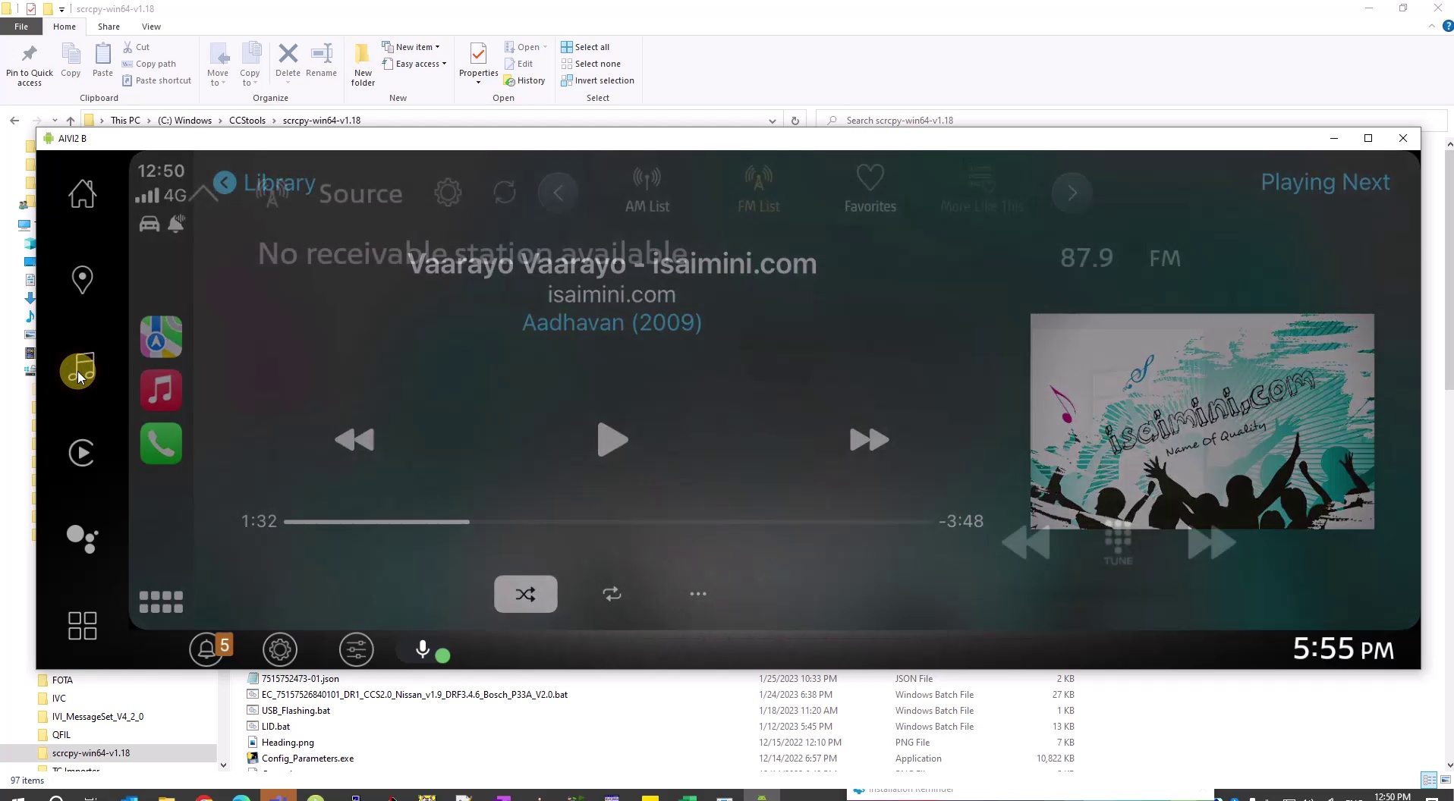
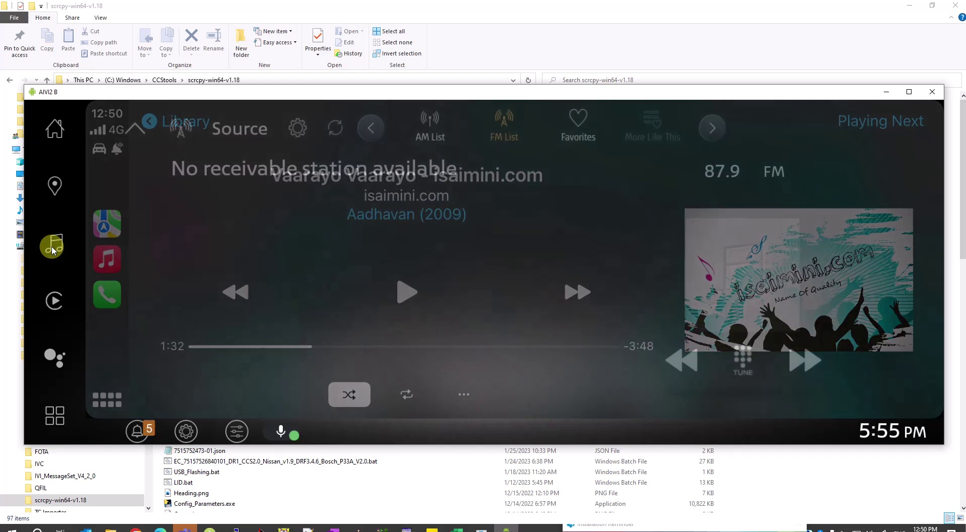
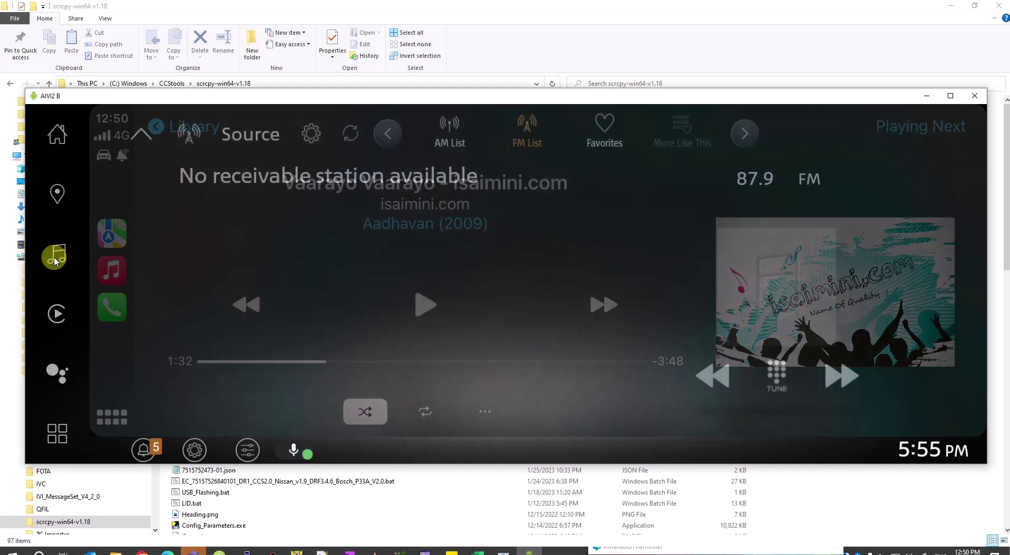

Shot detection
ISP008 foundation
Miniscule intervals between 2 cuts -> flicker (current implementation is < 0.4s)
PySceneDetect (github.com)
2
CISP-1352-A21 - ISP-DOC-STYLETYPE-Templates © Robert Bosch GmbH 2016. All rights reserved, also regarding any disposal, exploitation, reproduction, editing, distribution, as well as in the event of applications for industrial property rights.

Slide 3
Approach #1: Frame precision
ISP008 foundation
Frame number
102
103
104
105
2
CISP-1352-A21 - ISP-DOC-STYLETYPE-Templates © Robert Bosch GmbH 2016. All rights reserved, also regarding any disposal, exploitation, reproduction, editing, distribution, as well as in the event of applications for industrial property rights.

Slide 4
Approach #1: Frame precision
ISP008 foundation
102
103
104
105
detectFlicker
2
CISP-1352-A21 - ISP-DOC-STYLETYPE-Templates © Robert Bosch GmbH 2016. All rights reserved, also regarding any disposal, exploitation, reproduction, editing, distribution, as well as in the event of applications for industrial property rights.

Slide 5
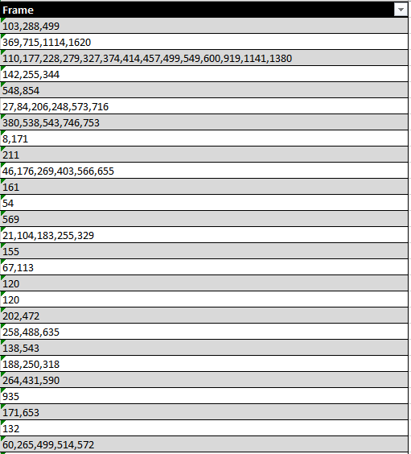
Approach #1: Frame precision
ISP008 foundation
102
103
104
105
detectFlicker
2
CISP-1352-A21 - ISP-DOC-STYLETYPE-Templates © Robert Bosch GmbH 2016. All rights reserved, also regarding any disposal, exploitation, reproduction, editing, distribution, as well as in the event of applications for industrial property rights.

Slide 6
Approach #1: Frame precision
ISP008 foundation
102
103
104
105
detectFlicker
Current performance
Correct (TP): 72
False (FP): 557
Missed (FN): 42
Too many false detections:
Load pages and widgets: normal(?) behavior
Missed:
Small difference between affected frames
Reduce missed hits might lead to increasing false detections
2
CISP-1352-A21 - ISP-DOC-STYLETYPE-Templates © Robert Bosch GmbH 2016. All rights reserved, also regarding any disposal, exploitation, reproduction, editing, distribution, as well as in the event of applications for industrial property rights.

Slide 7
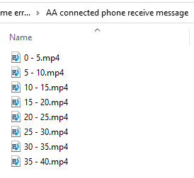
Approach #2: Divide into 5s clips
ISP008 foundation
Frame number
50
51
52
53
54
55
2
CISP-1352-A21 - ISP-DOC-STYLETYPE-Templates © Robert Bosch GmbH 2016. All rights reserved, also regarding any disposal, exploitation, reproduction, editing, distribution, as well as in the event of applications for industrial property rights.

Slide 8
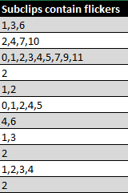
Approach #2: Divide into 5s clips
ISP008 foundation
50
51
52
53
54
55
detectFlicker => Clip has flicker
2
CISP-1352-A21 - ISP-DOC-STYLETYPE-Templates © Robert Bosch GmbH 2016. All rights reserved, also regarding any disposal, exploitation, reproduction, editing, distribution, as well as in the event of applications for industrial property rights.

Slide 9
Approach #2: Divide into 5s clips
ISP008 foundation
50
51
52
53
54
55
detectFlicker => Clip has flicker
Current performance
Correct (TP): 96
False (FP): 49
Missed (FN): 28
Issues?
2
CISP-1352-A21 - ISP-DOC-STYLETYPE-Templates © Robert Bosch GmbH 2016. All rights reserved, also regarding any disposal, exploitation, reproduction, editing, distribution, as well as in the event of applications for industrial property rights.

Slide 10
Approach #2: Divide into 5s clips
ISP008 foundation
not Flicker
Flicker
detectFlicker (False detection)
2
CISP-1352-A21 - ISP-DOC-STYLETYPE-Templates © Robert Bosch GmbH 2016. All rights reserved, also regarding any disposal, exploitation, reproduction, editing, distribution, as well as in the event of applications for industrial property rights.

Slide 11
Approach #2: Divide into 5s clips
ISP008 foundation
not Flicker
Flicker
detectFlicker (False detection)
-> Clip has flicker
=> True positive !!!
Very high chance of occuring
Evaluation results are not reliable
2
CISP-1352-A21 - ISP-DOC-STYLETYPE-Templates © Robert Bosch GmbH 2016. All rights reserved, also regarding any disposal, exploitation, reproduction, editing, distribution, as well as in the event of applications for industrial property rights.

Slide 12
Approach #3: Divide into clips of ~20 frames
ISP008 foundation
17
18
19
20
21
22
92
93
94
103
112
113
114
278
279
288
298
299
277
297
488
489
490
499
508
509
510
2
CISP-1352-A21 - ISP-DOC-STYLETYPE-Templates © Robert Bosch GmbH 2016. All rights reserved, also regarding any disposal, exploitation, reproduction, editing, distribution, as well as in the event of applications for industrial property rights.

Slide 13
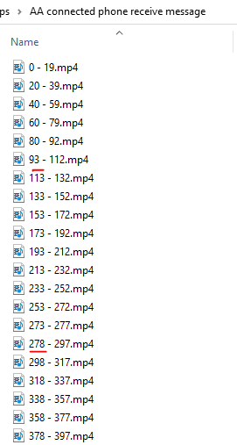
Approach #3: Divide into clips of ~20 frames
ISP008 foundation
Isolate frames with flickers
Help with analyzing false positives
Current performance
Correct (TP): 106
False (FP): 177
Missed (FN): 40
2
CISP-1352-A21 - ISP-DOC-STYLETYPE-Templates © Robert Bosch GmbH 2016. All rights reserved, also regarding any disposal, exploitation, reproduction, editing, distribution, as well as in the event of applications for industrial property rights.

